Slide 1

https://qdata.github.io/deep2Read/
Interpreting Deep Learning Models
Presented by Eli Lifland, 2/28/2020

Slide 2
Overview
What even is interpretability?
Why do we need interpretations?
Interpretation methods
Is attention explanation?
Problems with interpretations
Where do we go from here?
Notes:
The motivation of this project

Slide 3
What is interpretability in ML?
Depends who you ask: interpretability is a “suitcase word,” meaning it’s used to represent many different meanings
A general definition from Murdoch (2019):
Interpretable ML is the use of machine-learning models for the extraction of relevant knowledge about domain relationships contained in data
Notes:
The motivation of this project

Slide 4
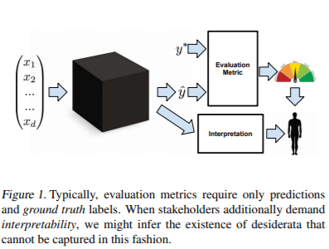
Why interpretations?

Slide 5
Why interpretations? Trust
Why can’t we trust an accurate model?
When training and deployment environments differ, we want to trust the model will still perform well
Feel comfortable relinquishing control to model
Does it make mistakes in similar cases to human?
Subjective notion of trust
Feel more at ease with well-understood model

Slide 6

Why interpretations? Causality
As we know, correlation does not imply causation
Help ensure model isn’t learning spurious correlations
Provides causal hypotheses which can be tested experimentally

Slide 7
Why interpretations? Transferability
Generalization to distributional shift
Scenarios where use of model alters environment
Robustness to adversarial attacks
Best to anticipate and understand failures to generalize

Slide 8
Why interpretations? Informativeness
Provide more information than just the prediction
Example: PhD student asks which venue best suits a paper, professor would not answer with the name of one conference
Note information can be provided without revealing model’s inner workings
Pointing out data points model saw as similar

Slide 9
Why interpretations? Fairness
Assessing whether decisions conform to ethical standards
Are models using variables we don’t want them to, reinforcing biases?
European Union says:
People have right to explanation
Algorithmic decisions must be contestable

Slide 10
Interpretation Methods: Overview
Post-hoc explanations
Feature visualization
Feature attribution
Instance-wise vs. model-wide
Feature visualization + attribution
Training example attribution
Inherently interpretable models

Slide 11
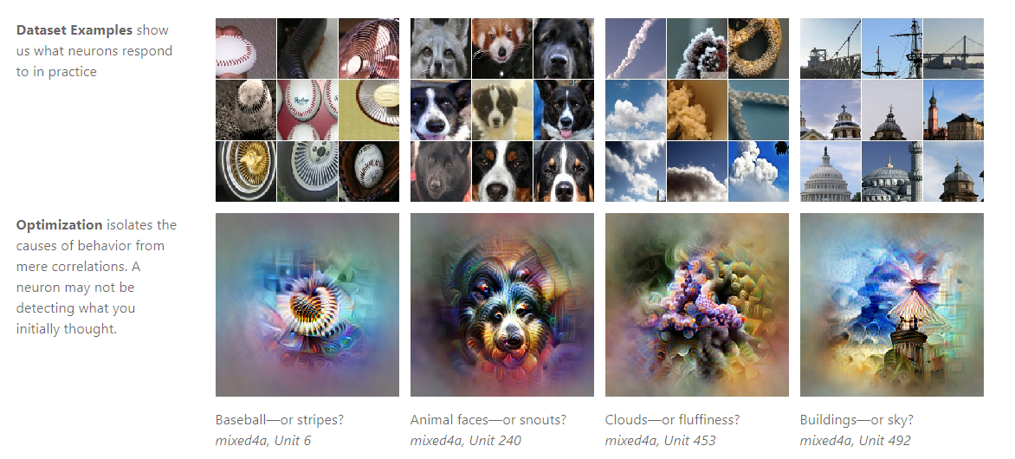
Feature Visualization

Slide 12
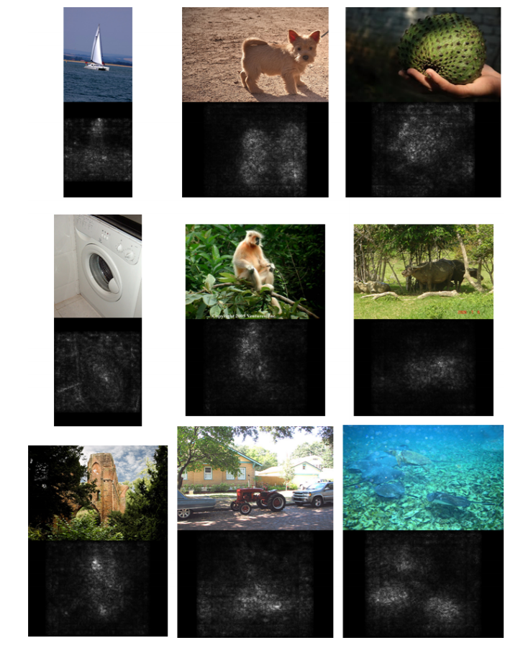
Instance-wise Feature Attribution: Saliency Maps

Slide 13
Feature Attribution: Shapley Approximation
Shapley value: method of determining the contributions of different players
Treat the features as players and the game is prediction
For set of features S, define marginal contribution of feature i to S as F(S) - F(S \ {i})
The Shapley value is the average marginal contribution across all possible subsets S containing i
But there are 2^{n} possible subsets
Lots of approximation methods

Slide 14
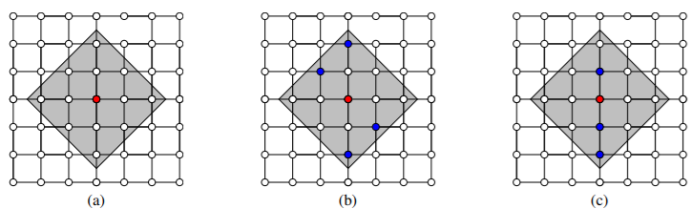
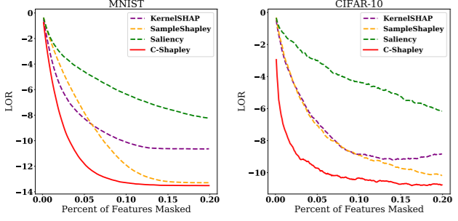
Feature Attribution: L-Shapley and C-Shapley

Slide 15
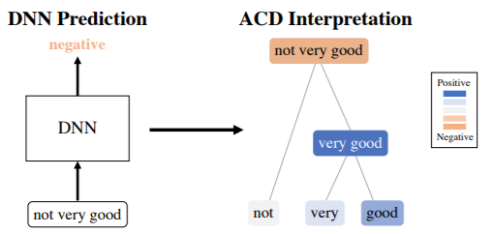
Feature Attribution: Contextual Decomposition (CD)
CD decomposes logits into sum of importance measures of feature groups, other factors
Captures both feature importance and interaction between features
Can be used for hierarchical interpretations

Slide 16
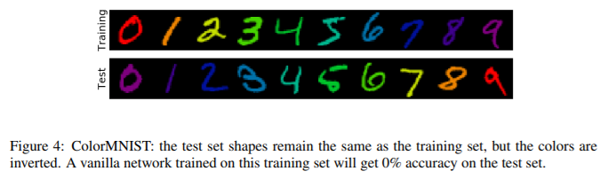
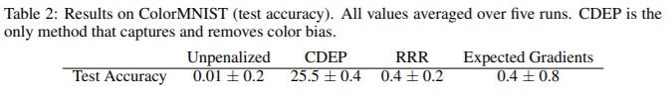
Feature Attribution: Contextual Decomposition (CD)
CD also allows for easily penalizing certain features or groups of features

Slide 17
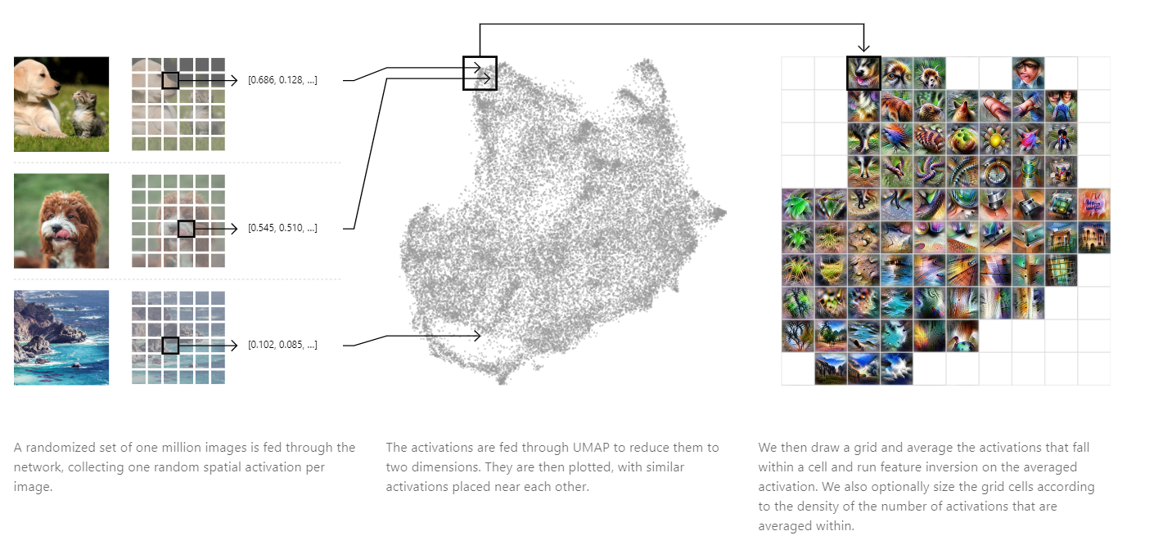
Visualization and Attribution: Activation Atlas
Notes:
https://distill.pub/2019/activation-atlas/

Slide 18
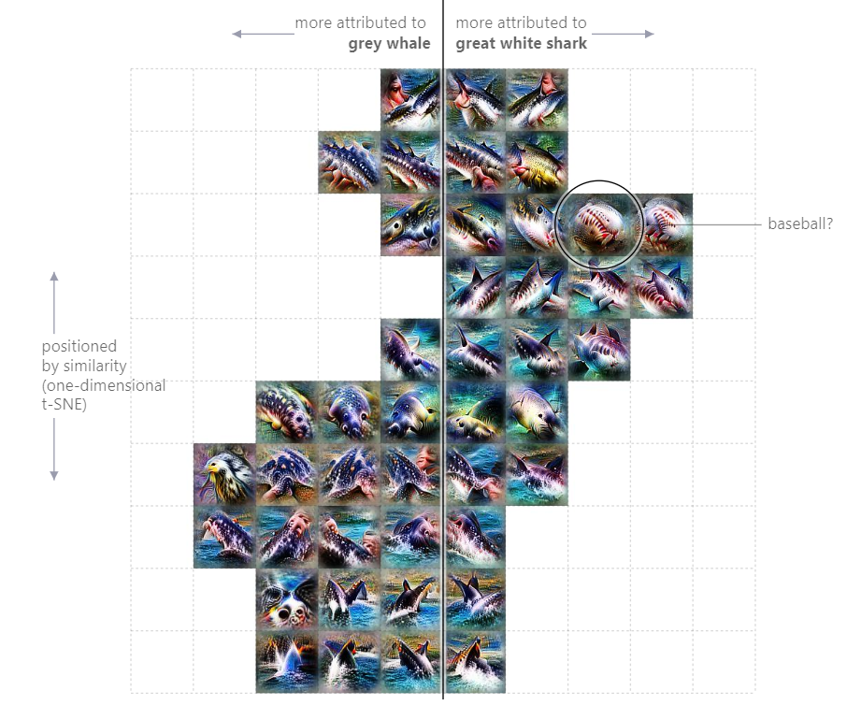
Visualization and Attribution: Activation Atlas

Slide 19
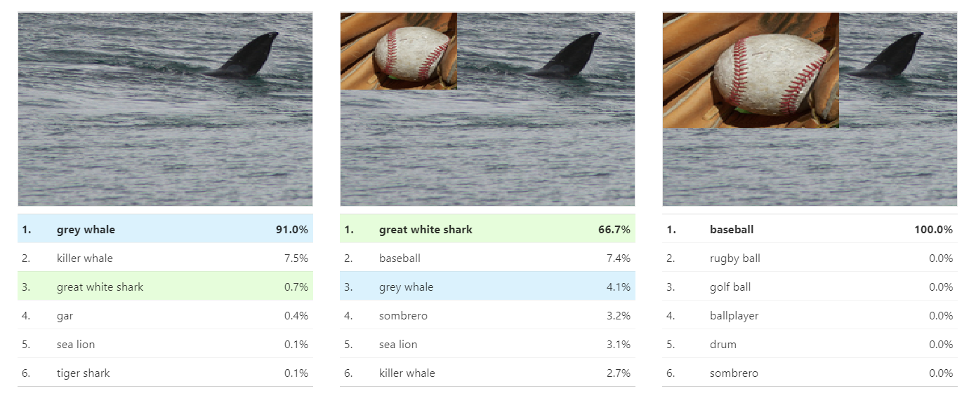
Visualization and Attribution: Activation Atlas

Slide 20
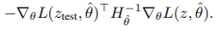
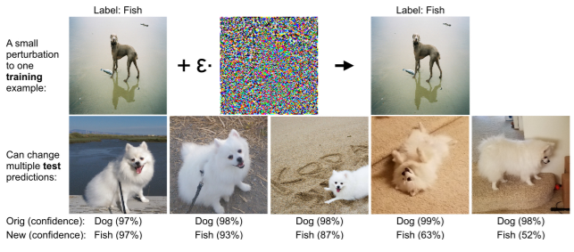
Training Example Attribution: Influence Function
Influence of upweighting training example z on loss at test point z_{test}:

Slide 21
Inherently Interpretable Models: Desiderata for Transparency
Simulatability: Human able to internally simulate and reason about entire decision-making process
Examples: linear regression, decision trees
Decomposability: Each part of model has an intuitive explanation
Algorithmic Transparency: Do we understand the shape of the error surface?

Slide 22
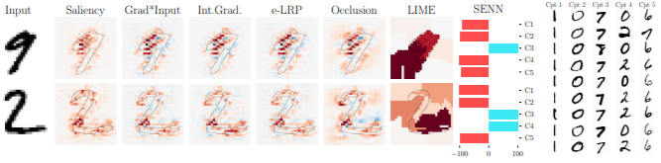
Inherently Interpretable Models: SENN

Slide 23
Are attention weights explanation?
Many in NLP have claimed attention weights provide insight into what model is looking at
They imply the weights provide an explanation for why the model makes its decision
But can attention weights really be viewed as an explanation?

Slide 24
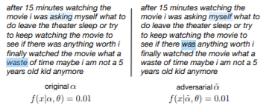
“Attention is Not Explanation”
Attention does not provide meaning explanation since:
1. Attention weights are frequently uncorrelated with feature importance scores
2. Can identify adversarial attention distributions which yield same prediction, very different explanation

Slide 25
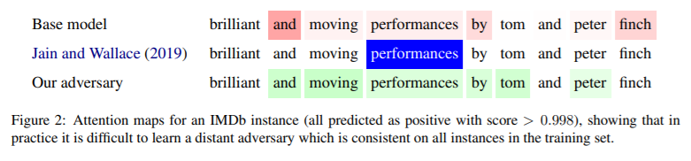
“Attention is Not Not Explanation”
Argues Claim 2 does not advance thesis, since:
Attention distribution is not a primitive
Must train model with adversarial objective
Existence doesn’t entail exclusivity
Provides an explanation, not the explanation

Slide 26
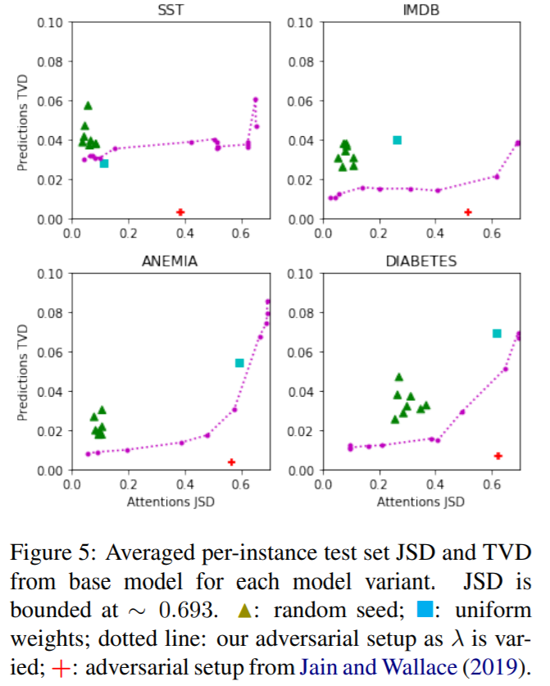
“Attention is Not Not Explanation”

Slide 27
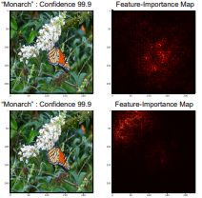
Interpretation Robustness: Interpretation is Fragile

Slide 28
Interpretation Robustness: Interpretation is Fragile
Series of steps in direction which maximizes differentiable dissimilarity function between original, perturbed interpretation
Top-k attack: Decreases relative importance of k most important features
Mass-center attack for image data: maximizes spatial displacement of center of mass of feature importance map
Targeted attack for image data: Increases concentration of feature importance scores in pre-defined region of image

Slide 29
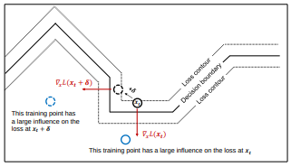
Interpretation Robustness: Interpretation is Fragile

Slide 30
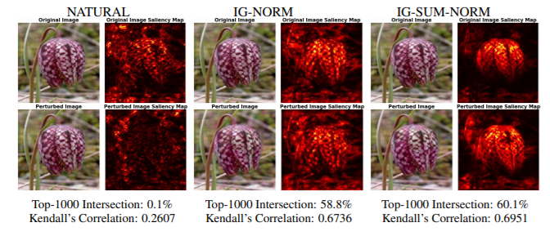
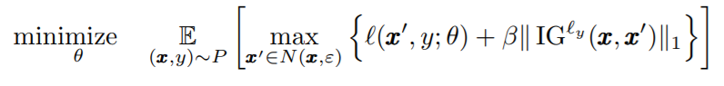
Interpretation Robustness: Robust Attribution Regularization

Slide 31
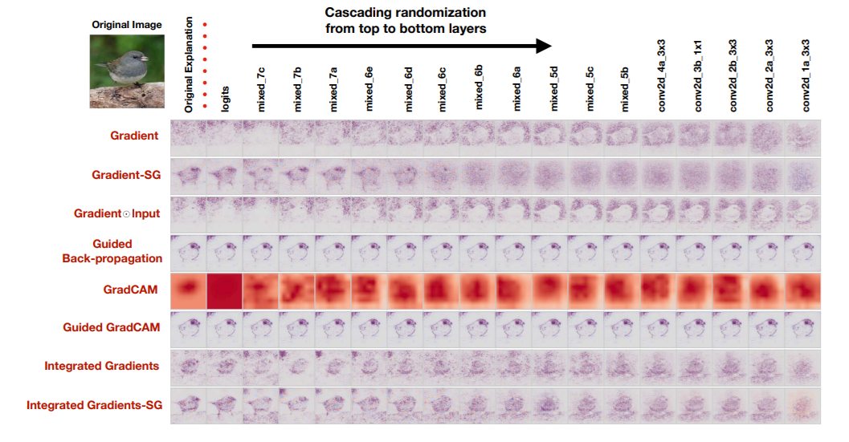
Sanity Checks For Saliency Maps

Slide 32
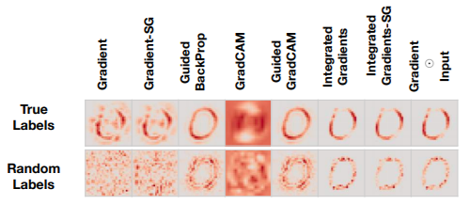
Sanity Checks For Saliency Maps

Slide 33
Where do we go from here?
Consensus, clarity on definition of suitcase words such as “interpretation” and “explanation”
Better and more standardized evaluation methods
Applying techniques similar to the Activation Atlas to text, audio
Acknowledgment and discussion of tradeoffs
Inherently interpretable models vs. post-hoc explanations
PDR
Continued exploration of better methods of both feature visualization and attribution, particularly understanding feature interaction

